Slide 1
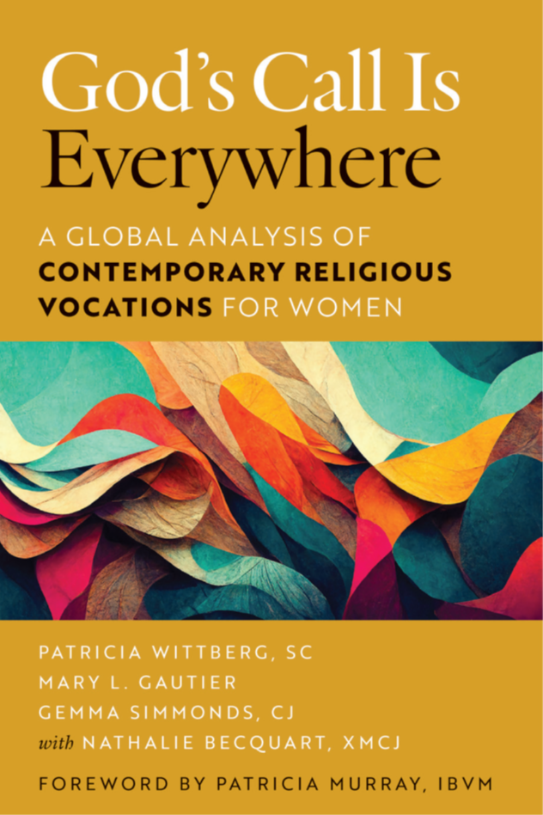
What do the quantitative data tell us?

Slide 2
What is a meta-analysis? And why???
Meta-analysis explores commonalities and differences in multiple studies conducted using similar methods in a similar time frame
  USA, Australia, France, Canada, United Kingdom, and Ireland
  All studies completed between 2009 and 2019
  All studies interviewed new members, most also surveyed new members
More complex understanding of patterns in the data
Capable of finding relationships across studies that are not apparent in individual studies

Slide 3
Characteristics of Newer Members Responding to the Surveys
 | 2009 USA | 2015 FRA | 2015 AUS | 2017 CAN | 2019 USA
Women religious respondents in dataset | 991 | 447 | 45 | 68 | 987
Approximate response rate among identified religious | 40% | N/A | N/A | 54% | 70%
Median age | 44 | 35-40 | 35-45 | 42 | 34
Percentage born outside survey country | 18% | 48% | 44% | 44% | 21%

Slide 4
Experiences of Newer Members Before Entering Religious Life
 | 2009 USA | 2015 FRA | 2015 AUS | 2017 CAN | 2019 USA
Average age first considered religious life | 20 | 19 | 15-19 | 22 | 18
Average age at entrance to religious institute | 32 | N/A | N/A | 38 | 29
Percentage post-high school education before entering | 85% | 80% | 80% | 84% | 89%
Percentage ever worked before entering | 90% | 45% | 91% | 99% | 86%
If worked before entering, percentage full-time | 82% | 75% | 71% | 75% | 73%
Volunteered in a parish or other setting | 54% | 30% | 68% | 57% | 58%
Volunteered in a religious institute | 9% | 10% | 23% | 9% | 10%
Attended a World Youth Day | 13% | 45% | 30% | 31% | 22%
Percentage ever married | 10% | 0% | 11% | 13% | N/A

Slide 5
Attracted "Very Much" to religious life by...

Slide 6
Attracted "Very Much" to their institute by...

Slide 7
Attracted "Very Much" to their institute by...

Slide 8
Influenced "Very Much" your decision to enter your institute

Slide 9
"Very Much" preferred composition of living setting

Slide 10
Institute is "Excellent" at these activities

Slide 11
Institute is "Excellent" at these formation activities

Slide 12
Key learnings from the data
More similarities than differences among newer members in these countries in age, nativity, education, work experience
Attracted to religious life by call from God, prayer, community life
Attracted to their institute by its spirituality, prayer, community life
Influenced by prayer life, community life, charism, and ministries
Prefer living with members of different ages, cultures, & ministries
Institute excels at community life, prayer, and relationships
Institute could do better at promoting vocations and preparing new members for ministry

Slide 13
Experiences from the
Global South

Slide 14
New Entrants to Religious Life in Kenya
Religious life in Kenya is still prevalent among young people. The majority tend to join a religious institute after high school. In 2017 and early 2018, a survey was distributed to different formation houses to collect data from new entrants to religious life in Kenya. In total, 500 surveys were shared with individual aspirants/candidates/postulants of different congregations through their formatters. Of these 500 identified women and men, 407 responded to the survey. This represents a response rate of 81 percent of the entrance class of 2017 in Kenya.

Slide 15
New Entrants to Religious Life in Kenya
In the study of women and men entering religious life in Kenya, in 2017 a total of 500 surveys were distributed, out of which 407 were duly completed. We gathered information about the characteristics and experiences of these men and women, using a similar questionnaire and methodology to that used for “the entrance class of 2016” survey, which the Center for Applied Research in Applied Research in the Apostolate (CARA) conducted among U.S. religious institutes. The report relies entirely on quantitative and qualitative responses that were contained in the survey. Where possible a comparison has been made between Kenyan responses and those of the US in 2016 (Ngundo & Gautier, 2017)
\

Slide 16
Characteristics of Respondents

Slide 17
Catholic Status
The 2017 study done in Kenya shows nearly similar results to the study done in CARA in 2016 whereby, overall one in eight say both parents are Catholic. Eight in ten (79 percent) women and just over eight in ten (83 percent) men report both parents are Catholic.
CARA Entrance Class of 2016, p. 11

Slide 20
 | What was the highest level of education you completed before you entered religious life?
 | Percentage responding
 |  | Overall | Women | Men
 | High school or less | 52% | 52% | 53%
 | Some college | 43 | 43 | 42
 | Bachelor’s degree | 4 | 4 | 4
 | Master’s degree | 0 | 0 | 0
 | Doctoral degree | 0 | 0 | 0
 | Other | 1 | 1 | 1

Slide 21
Comparison by Country
The two studies clearly show that those who entered religious life in the US in 2016 were more educated than those entering religious life in Kenya in 2017, meaning that they had a higher
A comparison of the US and Kenyan studies shows that those entering religious life in the US in 2016 were more likely to have higher academic qualifications and therefore better work experience than those entering religious life in Kenya in 2017 before entry into religious life.

Slide 22
 |  | How Much Did the Following Attract you to Religious Life?
 |  | Percentage checking each response
 |  |  |  |  |  |  |  | “Somewhat or “Very much” |  |  | “Very much” Only
 | A desire to be of service to the Church |  |  |  |  |  | 97% |  |  |  | 89%
 | A sense of call to religious life |  |  |  |  |  | 90 |  |  |  | 78
 | A desire for prayer and spiritual growth |  |  |  |  |  | 89 |  |  |  | 76
 | A desire to reach out to the poor |  |  |  |  |  | 89 |  |  |  | 72
 | A desire to be part of a community |  |  |  |  |  | 78 |  |  |  | 52
These findings show some of the positive motivations of
a new entrant into religious life. These elements focus on the
inner and essential rudiments in religious life. In reality, one
should enter religious life in order to devote oneself to the service of God, to prayer and to remain intimate with Our Lord
like Mary (Luke 10:39)

Slide 23
 | How Much Did the Following Attract You to Your Religious Institute?
 | Percentage checking each response
 |  | “Somewhat” or “Very” much |  |  |  | “Very much” Only
 | The prayer life of the institute | 90% |  |  |  | 78%
 | The mission of the institute | 89 |  |  |  | 68
 | The life and works of the Founder/res | 82 |  |  |  | 62
 | The community life of the institute | 80 |  |  |  | 59
 | The institute’s fidelity to the Church | 88 |  |  |  | 59
 | The spirituality of the institute | 90 |  |  |  | 50
The choice of a religious institute is often complicated by individual confusion and indecision. An aspirant once told me that she was attracted to our religious institute by our religious habit. My question to her was, “Suppose the habit that attracted you was withdrawn, what would become of you?” The question about one’s attraction to their religious institute is essential in assessing the real motivation for entering religious life.

Slide 24
Among the things that respondents say they like about their present religious institute are, the community life and unity of members, the charism and spirituality of the Founder/res, prayer and prayer life of the institute, religious formation, and the open joyful spirit of members.
“Fraternal living in the community and genuineness of members. Prayer life is one that I like”.
“The solidarity and the care of one another in the congregation. The spirituality and living together”.
“I like the community life of the members, their faith sharing, eating together, working together, and keeping one
another in mind”.
“

Slide 25
New entrants to religious life in Kenya were further invited
to share what they find most challenging as members of their institutes. Respondents shared many challenges, including community living, language barriers, adapting to a new way of life, and religious formation, among others. A few of their comments relative to some of these challenges are presented below.
“Living together in a community and understanding people of different cultures is proving to be a challenge”.
“The institute language is English yet not all of us are English speakers. Communicating with others is difficult”.

Slide 26

You promote vocations
You promote the Church
Sr. Bibiana Ngundo (LSOSF)

Slide 27
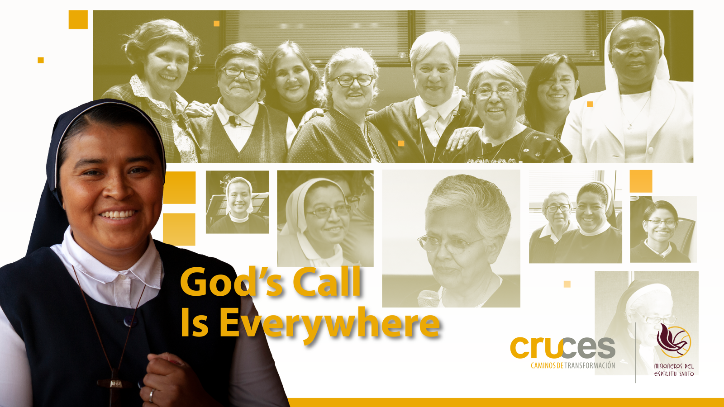

Slide 28
The Life of Religious Women in Mexico: Elements for Further Reflections
Chapter 6. “God’s call is everywhere”
Fr Luis Fernando Falcó MSpS

Slide 29
Where this Chapter comes from, its data and reflections
From the constant work at Cruces Project and from the Development and Health Office of the Religious Sisters in Mexico.
The service as a trainer of religious people for 21 years.
Particularly at Cruces Project, for 10 years, through the Systematic Courses for Formators, which have provided a complex and rich material to understand the difficulties that institutes face to embrace the change and novelty represented in new candidates.
The research on Elder Religious Sisters in Mexico has confirmed these data from a more analytic perspective.

Slide 30
The style of "consecrated life" differs from the cultural mainstream: to what extent and in what sense?
How much "differentiation" is acceptable and desirable for Consecrated Life in the Latin American context, given that, historically, religious women have been recognized as decisive agents in the construction of society?
On one hand, it intends to be recognized with different values: “being in the world without being the world”.
However, this does not mean that Consecrated Life cannot be distinguished or is irrelevant for a large number of young people.

Slide 31
Religious life is increasingly perceived as socially distanced: sadly, not known neither understood
It is increasingly hard to find young women interested in this vocation. Newcomers are scarce within institutes.
Religious Life is especially distant from the cultural horizon of young men and women.
Partially explained by the pluralization of Religious beliefs, but not only.
It also seems that religious congregations in Mexico are reluctant to go towards a proactive adaptation movement.

Slide 32
The growing gap among Congregations and Young Women
The ways in which religious women represent themselves and their daily life practices are different from those in which young Mexican women are socialized.
Many institutes do not even consider the urgency of generating an adaptation plan to make themselves attractive to young women in Mexico and other Latin American countries.
For this reason, the data are incontrovertible: fewer and fewer young Mexican women find consecrated life on the horizon of plausible or meaningful options for their lives.

Slide 33
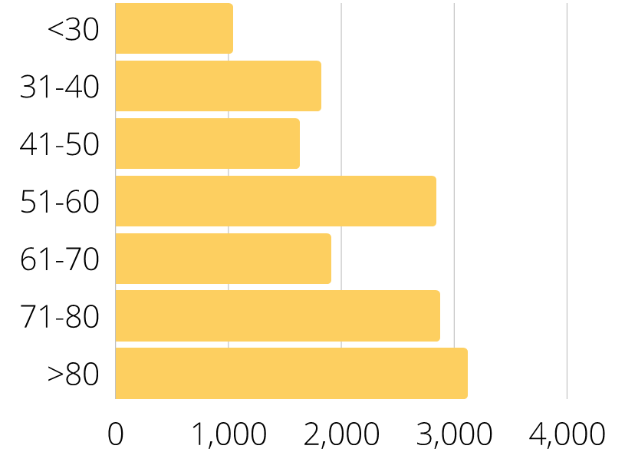
Age Group The Life of Religious Women in Mexico/ DSI – Cruces Research Team / 2022
Age Range | Population | %
<30 | 1035 | 7%
31-40 | 1817 | 12%
41-50 | 1625 | 11%
51-60 | 2840 | 19%
61-70 | 1906 | 13%
71-80 | 2869 | 19%
>80 | 3114 | 20%
Total | 15206 | 100%

Slide 34
% Total
The entering vocations are insufficient for reverting the decreasing trend, but in communities with more than a hundred members it will be even more difficult because they need many more aspirants.
Type | Total | %
Aspirant | 253 | 2.1%
Postulant | 205 | 1.7%
Total | 458 | 3.8%

Slide 35
Adaptation Efforts have not been considered systematically
The way of life pursued in congregations makes it hard for young women to assume everyday life in a community even when they feel attracted to Religious Life.
Routines around personal life: eating, resting, spare time, going out of the house with friends, jobs and chores, family visiting, doing apostolic and pastoral tasks.
Also, practices around obedience, poverty and chastity are difficult to be understood and assumed by young people.

Slide 36
It seems easy to blame young people of being unwilling to follow evangelical values, but…
…religious communities hesitate to generate modifications within their formation strategies to make them understandable and bearable for younger vocations.
  Making separation periods not so strict.
  Fostering the bonds with their own families.
  Encouraging that each one finds and follows their own and personal path in community life and in the apostolic endeavor.
  Facilitating that each Sister fosters her own friendship relations in community and beyond.

Slide 37
Religious life could be offered as a life alternative for young women in Mexico and Latin America when…
Congregations listen with open heart, mind and will to the voices of young candidates.
They recognize their own blind spots and not only justify their own traditions.
They recognize that modern lifestyle does not always lack values, but it is just another way of pursuing happiness and congruency.
It would imply a serious review of their formation strategies, assuming that:
    Every Sister must find her own personal vocation within the common congregational charism.
    Differentiated paths must be traced for each one in community.
    If the congregational culture and practices come to be significant for the young people, it would be because of the spiritual life and joyful testimony.

Slide 38
Generational and Cultural Differences

Slide 39
Similarities Across Countries
Reasons for Entering Religious Life
Called by God, desiring Prayer, spiritual growth
Attracted by community living, prayer
Difficulties and challenges
Obedience, surrendering one’s will
Community living

Slide 40
Reasons for Entering
I wanted . . . To have Christ at the center of my life. I didn’t want it to be just, like, going to Mass on a Sunday. (United Kingdom)
I had a call, but it was made many times and in a very discreet way. (France)
I am drawn to religious life primarily by a sense of call and a desire for prayer and spiritual growth. (India)
I enjoy community life and prayer together like the first community in the Bible. (Australia)
Community is one of the main reasons I wanted to enter religious life. (United States)
The spirituality and living together. (Kenya)

Slide 41
Difficulties and Challenges
Living community life in small communities with sisters “set in their ways.” (Australia)
Community living, especially with members of different cultures and intergenerational. (Canada)
Community life is, of course, difficult. A lot of it is just not being able to have things the way you would want them. (United Kingdom)
The renunciation of self, of one’s own will, that is the most difficult. (France)
Asking permission for most things I want to do. (Mexico)
Some rules in the congregation are very hard to follow. Fixed schedules with no room for dialog… All these are disturbing since we are grownups. (Kenya)
The call to give up one’s will. (Canada)
The struggle against sin, the day-to-day fidelity to Him through obedience and docility. (Australia)

Slide 42
Differences Across Countries
The Role of Religion and Vowed Religious Life
Religion pervades society (and vowed religious are honored)
Religion is part of a nation’s identity (and vowed religious are honored)
Religion is peripheral (and vowed religious are invisible)
Religion was once pervasive but not any more (and vowed religious are looked down upon)
Societal Background Factors
Class/caste/ethnic divisions
Demography: number of children per family
Other opportunities for women
Social media/technology

Slide 43
The Role of Religion and Religious Life
Although I was raised Catholic and attended Catholic schools from preschool through college, I experienced a lack of exposure to religious life that resulted in not thinking of it as a possibility. (United States)
Students today do not know anything about sisters and religious life. Most have not even met a sister. (United Kingdom)
Our public image is one of aging sisters in wheelchairs. (United States)
There is a huge kind of pressure within the school from the other students, not to be interested in God. (Ireland)
I was seen as old fashioned and a bit taboo when I told my friends I was discerning. (United States)
My greatest worry was my family. My worry was not to hurt them, because it was a rather radical step. (France)
My mum’s immediate reaction was, “How could you even consider such a thing?” (United Kingdom)

Slide 44
Societal Background Factors
The Church used to be very working class but now it is more middle class. (United Kingdom)
Understanding people of different cultures is proving to be a challenge. (Kenya)
Authorities should consider all the members equally and not treat them differently based on their caste and language. (India)
I have three brothers, but I am the only daughter, with all the emotional questions that come from that. (France)
Many families have few children. Often it is one [child] nowadays. (India)
There are so many opportunities for women in today’s world. (United States)
There is so much good young people can do as laypeople. (Australia)

Slide 45
Differences Across Generations
Creating a Generational Culture of Religion
  Prevalence of religious beliefs and practices in Childhood and Adolescence
  Societal background effects
“Fresh Encounter:” Adopting a Generational Outlook
  Cognitive Minorities vs. Religious “Nones”
  Interactions with class, nationality, ethnicity, and gender
U.S. Example
Pre-Vatican II Generation
Vatican II Generation
Post-Vatican II Generation
Millennials
“Gen Z”

Slide 46
Generational Differences and Concerns, U.S.
I guess what most concerns me is I may become preoccupied with apostolic work without remaining rooted in deep prayers and letting that feed the apostolate. (United States, age 30)
I worry that I will get burned out with teaching or get too wrapped up in school that my prayer life suffers. (United States, age 36)
I hope we will look at different ways to serve instead of just education and administration. (United States, age 52)
The changes I see in other communities. I want to preserve what we have by living it faithfully. (United States, age 37)
I hope we remain faithful to God’s will and our charism. I hope we are led by the Spirit and continue to grow in vocations and holiness. While remaining faithful to Mother Church. (United States, age 28)
That we won’t make the big shifts we need to in the next ten years. I worry we are still hanging on to the past. (United States, age 35)

Slide 47

Generational and Societal Cultures Influence
Whether young people will enter vowed religious life
Areas of decline: U.S., Canada, Australia, Western Europe
Areas of growth: Kenya
Areas in transition: Mexico, India
Who will enter vowed religious life
Marginalized social groups
Ideological minorities
What charisms will attract them
Religious life as prophecy: meeting the hungers/discontinuities of the age
Religious life as ministry: providing a needed service

Slide 48
Predictions and Recommendations
Answering the Changing Hungers/Discontinuities in each society
Stimuli overload ← → Silence/Centering/Reflection
Individualism ←→ Community
Margins ←→ Service/Social Justice
Environmental Catastrophe ←→ Caring for the Earth
Others?

Slide 49
Societal Hungers and Religious Life: Silence
I think the greatest obstacle for discerners is emotional stimulation – the constant temptation to fill the void, to drown out the silence, to find satisfaction in transient pleasures. (United States)
Misguided by media, youth often fall prey to the temptation of false havens, to the culture of fun and entertainment, filled with passion and without the strength to love. The present generation lives in a culture of fragmentation where stable values and permanency have no meaning. (India)
Not knowing how to pray or have a relationship with God and not having silence in their life is also a struggle. (United States)
[What was most difficult was] quitting my cell phone and social networks; not visiting family and friends frequently. (Mexico)

Slide 50
Generational Hungers and Religious Life: Community
I think the one thing that I hadn’t expected was, there is just how much fun we would have together, you know? (United Kingdom)
I like the community life of the members, their faith sharing, eating together, working together, and keeping one another in mind. (Kenya)
My idea of community would be … more about how we relate, the depth of relationship, sharing houses in smaller groups, and living and sharing faith. (Ireland)
Our culture teaches us to be extremely self-centered and focused on “self-fulfillment.” It is difficult to freely and wholeheartedly make a total gift of yourself. (United States)
Community life and trying to adapt to the culture of religious life, as it is so different from the culture of the world that I have been brought up in. (Australia)

Slide 51
Going to the Margins?
[I hope] that we are able to build ourselves up through additional multi-cultural and multi-economical members. (United States)
[I hope for] more women entering, especially from diverse cultures, socio-economic backgrounds, and ministerial backgrounds. (United States)
India is able to get vocations from tribal belts. That’s a sign of hope. (India)
********
Getting along with other members who are of a different nationality and don’t understand our culture of living. This can be extremely frustrating for them and for myself. (Canada)
Sometimes . . . the vocations are primarily from economically poor families. Some join religious life to equip themselves . . . to get a job. (India)
Discerners from foreign countries – VISA, etc. (United States)

Slide 52
The Generation Gap
Understanding youth cultures
The Generation Gap: Differences in the charism(s) that attract them
Generational Unbalance in institutes
Variations by Country

Slide 53
Generational Variations across Countries:
The Generation Gap
I am concerned the most of diminishment, of being the only young person in my community. I am concerned that there will be less viable communities to live in or that I will be living on my own. (United States)
[One obstacle is] the lack of younger women to give energy, new life, and hope to our community. (Australia)
At times it feels like formation directors do not understand the needs of the young because they are often more than 30-40 years older than us. (United States)
Having formation along an organic style is very different from the military style formation that happened many years ago. “Generation Gap” has returned! (Australia)

Slide 54
Questions for Table Discussions
What stood out for you in today’s presentations?
What is something you learned today that can be used in your institute’s vocation/formation ministry or by its leadership?

