Slide 1
If you f eel sad do think of me
f o r that’s what I’ll lik e . When you li v e in the hearts
of those you love rem emb e r t h e n you n e v e r d i e .
(Farewell My Friends - Rabindranath Tagore)

Slide 2
Ritual
Footprints on the Sands of Time
Welcome
I welcome you to our liturgy of remembrance for all our loved ones who have died. The month of November gives us a special opportunity to pause together to remember their love, their faith and their generosity as they walked the path of life. Their footprints, in good times and in difficult times are carved in the earth and, forever, they remain close beside us, deep in our hearts.

Slide 3
Leader:
God, be our shelter in time of need.
Response:
Give us voice to proclaim your love.
Leader:
O Divine Mystery
Response:
We praise and thank you for all our beloved ones who have gone before us and now rejoice in your presence.
Leader:
Happy are those who die in the Lord.
Response:
happy, indeed, now they can rest forever after their work, since their good deeds go with them.
Opening Hymn: In the Stillness
In the stillness of this moment there is peace, there is peace,
In the stillness of this moment there is peace, there is peace,
And I rest, and trust, and breath, and know
That in the stillness of this moment there is peace.
(There is love, I feel love, I am peace, I am love, I am)
(Words & Music: Karen Drucker CD Shine)

Slide 4
Ritual of Remembrance
Play soft music of your
Sisters names are read from the Book of R . After reading we are invited to hold a minute of silence.
Let us pray together:
Christ, be our light! Shine in our hearts.
Shine through the darkness. Christ be our light!
Shine in Your church gathered today.
choice
emembrance

Slide 6
Romans 8:38 – 39
For I am certain of this; neither death nor life, nor angels, nor principalities, nothing already in existence and nothing still to come, nor any power, nor the heights, not the depths, nor any created thing whatever , will be able to come between us and the love of God, known to us in Christ Jesus.
Pg. 5

Slide 7
Psalm 16
(Nan C, Merrill)
Remain ever before me, O Living Presence,
for in You am I safe.
You are my Beloved; in You and through You
I can do all things.
I look to those who are at one with You and learn
from them of your ways;
My delight increases each time I sense your Presence
within me!
Songs of praise well from my heart!
Pg. 6

Slide 8
Love is my chosen food, my cup, holding me in its power.
Where I have come from, Where’er I shall go,
Love is my birthright, My true estate.
I bless the Counselor who guides my way; in the night also does my heart
instruct me.
I walk beside the Spirit of Truth; I celebrate the Light.
I bask in The Oneness of All!
Thus my heart is glad, and my soul rejoices; I shall not be afraid,
nor fall into the pit of despair;
For in Love’s presence I know fullness of joy.
You are my Beloved and, in You will I live forever!
Pg. 7

Slide 9
Reflection
I died in the springtime of my days Before my dreams were painted On the landscape.
Your gentle dry and muffled sob followed me to the horizon.
That is the way it is In death’s dark hour,
One is broken in many pieces And the other is made whole.
I left the time capsule On that November day
As sunrise painted gold and red secrets Over my rising star
And the dawn breeze whispered music on my skin. In that moment of passing on my eyes spilled over
with the intensity of the beauty that held my soul.
As I crossed the bridge you were there beside me Letting me go
Into the fire.
Pg. 8

Slide 10
I was drawn by desire to touch the source, What I saw before me was beyond my thoughts, beyond my dreams
And I was taken into the great embrace.
I do not want you to fall apart. Our lives are forever entwined.
Thank you for your great liberating love;
It gave me strong roots of faith and courage and identity
And it gave me wings.
You let me fly, unhindered, in eagle flight to explore shapes and colours and rainbows and possibilities
And now I am forever young.
Heaven reminds me of my family home God looks so much like you.
Do not search for me among the dead; the stone is rolled back. I am alive.
Pg. 9

Slide 11
Intercessions
O Divine Mystery, people of every nation on earth have offered you their lives in service. Age after age, your glory has been revealed through their deeds of justice and mercy. May we learn how to serve you through the witness of their lives, and may we be strengthened by the power of their prayer for us.
With them, we pray. Saints of Asia, pray for us;
That the seed of faith planted in your land may bring forth a rich harvest.
All: Saints of Africa, pray for us;
That the gifts of your people may enrich the faith of all peoples and creeds.
All: Saints of Europe, pray for us;
That our Christian heritage, preserved through times of prosperity and times of persecution, may be treasured by all believers.
All: Saints of North America, pray for us;
That we may stand before the world as witnesses to God’s generous love.
Pg. 10

Slide 12
All: Saints of Central and South America, pray for us;
That we may learn from you how to walk with the poor and oppressed within the whole community of life.
All: Saints of the Near and Far East, pray for us;
That your reverence for the holy may inspire us to live mindfully.
(Source: Intercessions of Mercy, adapted)
Pg. 11

Slide 13
Concluding Prayer
In the name of Jesus who loves us into life. In the name of Mary, mother of God, mother of the nations.
In the name of Joseph who dreamed the
dream we offer our prayer of this day for all who have died, in our families,
in our communities, in our neighbourhoods, in the community of all life:
Eternal rest give to their souls O God and let perpetual light shine on them. May they rest forever in the fullness of Light.
Amen

Slide 14
Blessing: Absence (optional)
May you know
that absence is full of tender presence and that nothing is ever lost or forgotten.
May the absences in your life be full of eternal echo.
May you sense around you the secret Elsewhere which holds the presence that has left your life.
May you be generous in your embrace of loss.
May the sore well of grief
turn into a well of seamless presence.
May your compassion
reach out to the ones we never hear from and may you have the courage
to speak out for the excluded ones.
May you become
the gracious and passionate subject of your own life.
May you not disrespect your mystery through brittle words or false belonging.
May you be embraced by God
in whom dawn and twilight are one,
and may your belonging inhabit its deepest dreams within the shelter of the
Great Belonging.
(John O’Donohue)
Pg. 12

Slide 15
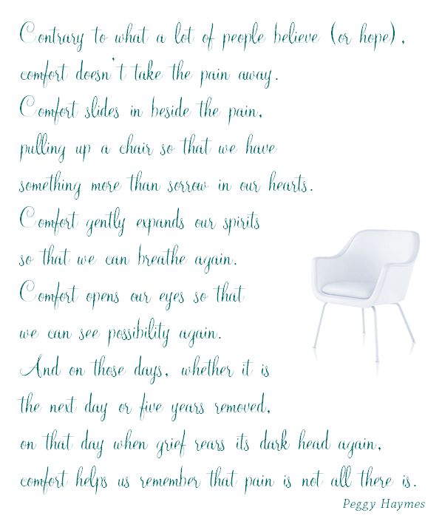
Mercy Congregational Office
Rachamim|13/14 Moyle Park| Convent Road| Clondalkin| Dublin 22|Ireland

