Slide 1
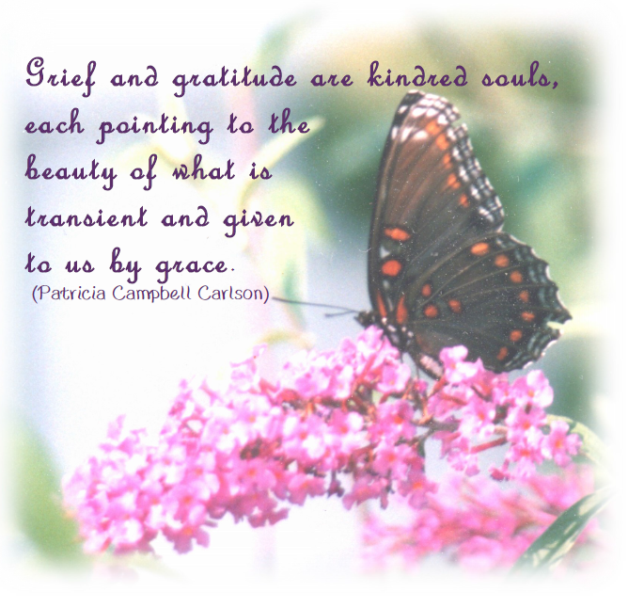

Slide 3
Introduction
Welcome
*Today/This evening, we remember those who have died. In recalling them we give thanks. They have been sources of encouragement to us by the way they lived as persons of strong faith and great love.
Through our remembrance of them may we be renewed and re-inspired in our journey of spiritual transformation.
Hymn: Being of Life
(Track 4, CD The Peace of God by Briege O’Hare, osc and sung by Marie Cox, rsm)
Or Enfold me in your Love
(Track 6, CD Holy Ground by Monica Brown)
Or A Hymn of your Choice
*Adapted from Prayer Seeds: A Gathering of Blessings, Reflections and Poems for Spiritual Growth© by Joyce Rupp. Used by permission of Ave Maria Press®, Inc. All rights reserved.

Slide 4
*Prayer
Leader: Let us call into our midst the presence, the memory and the strength of those who influenced and shaped our beliefs and values.
Loving God, this day we join in acknowledging the blessedness of the many who inspired us and shaped our faith.
We turn in memory and appreciation toward those in our family of origin who influenced and encouraged us to live as our best selves…
We remember, too, those who left this world with hurts unresolved…
We open our deep self to you and pray that any woundedness we have inherited will be healed through your grace and our loving hearts…
We bring to mind our departed sisters who enriched our lives and led us further on our journey of personal transformation…
We honor all those who sacrificed and suffered in order for peace and justice to be furthered on our planet…
We give thanks and rejoice for the countless, unnamed persons whose lives left a lasting mark of kindness and compassion…
*Adapted from Prayer Seeds: A Gathering of Blessings, Reflections and Poems for Spiritual Growth© by Joyce Rupp. Used by permission of Ave Maria Press®, Inc. All rights reserved.

Slide 5
May the remembrance of each of these blessed ones inspire and increase our personal commitment to leave a trace of goodness wherever we go…
When we depart this sphere of life may our inner strength have contributed to individual and world peace.
Time of Silence
Choose the 1st Reading from Jeremiah 18 and Sirach 33 or the 2nd Reading from Abbey of the Arts.

Slide 6
₁st
Reading
Reader 1: God said to me, “Go down to the potter’s house, where I will give you my message.” So I went there and saw the potter working at the wheel. Whenever a piece of pottery turned out imperfectly, the potter would take the clay and make it into something else.
Reader 2: Then God said to me, “Don’t I have the right to do with you people of Israel what the potter did with the clay? You are in my hands just like clay in the potter’s hands. If at any time I say that I am going to uproot, break down, or destroy any nation or kingdom, but then the nations turns from its evil, I will not do what I said I would. On the other hand, if I say that I am going to plant or build up any nation or kingdom, but then that nation disobeys me and does evil, I will not do what I said I would… Don’t I have the right to do with you people of Israel what the potter did with the clay?” (Jeremiah 18:1-10)
Reader 3: Just as clay is in the potter’s hands for the potter to shape as the potter pleases, so we are in the hands of our Creator for the Creator to
do as the Creator wishes.
(Sirach 33:13)
Pause
Leader: …we ask for the capacity to use our sufferings in such a way that we are forever vulnerable to the shape God has in mind for us.

Slide 7
2nd Reading
*Reading: from Abbey of the Arts, Newsletter, Christine Valters Paintner.
The Christian feasts of All Saints and All Souls on November 1 and 2 honour the profound legacy of wisdom our ancestors have left to us.
Psychologist Carl Jung wrote extensively about the collective unconscious which is this vast pool of ancestral memory within each of us. It is a kind of deposit of ancestral experience. He believed it comprises the psychic life of our ancestors right back to the earliest beginnings. Nothing is lost. All of the stories, struggles, and wisdom are available to us.
Each of us is an unconscious carrier of this ancestral experience and part of our journey is to bring this to consciousness in our lives... The stories of our ancestors are woven into the fabric of our very being.
*Adapted from Prayer Seeds: A Gathering of Blessings, Reflections and Poems for Spiritual Growth© by Joyce Rupp. Used by permission of Ave Maria Press®, Inc. All rights reserved.

Slide 9
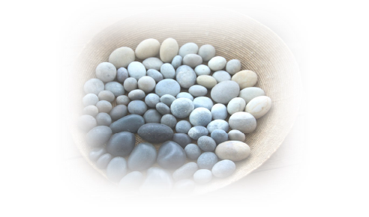
*Honouring the Strength of the Ancestors
A basket of medium-sized stones is passed around. Each person chooses one to hold. These stones represent the ancestral gift of strength. The group stands in a circle. As the stones are held, the names of the ancestors are proclaimed in the following way.
Each person speaks the name of one Ancestor/Sister/ Family Member/Friend/Partner in Ministry etc. After each name is spoken, all respond:
Guide us and grant us your strength
Continue going around the circle until all names are spoken.
*Adapted from Prayer Seeds: A Gathering of Blessings, Reflections and Poems for Spiritual Growth© by Joyce Rupp. Used by permission of Ave Maria Press®, Inc. All rights reserved.

Slide 10
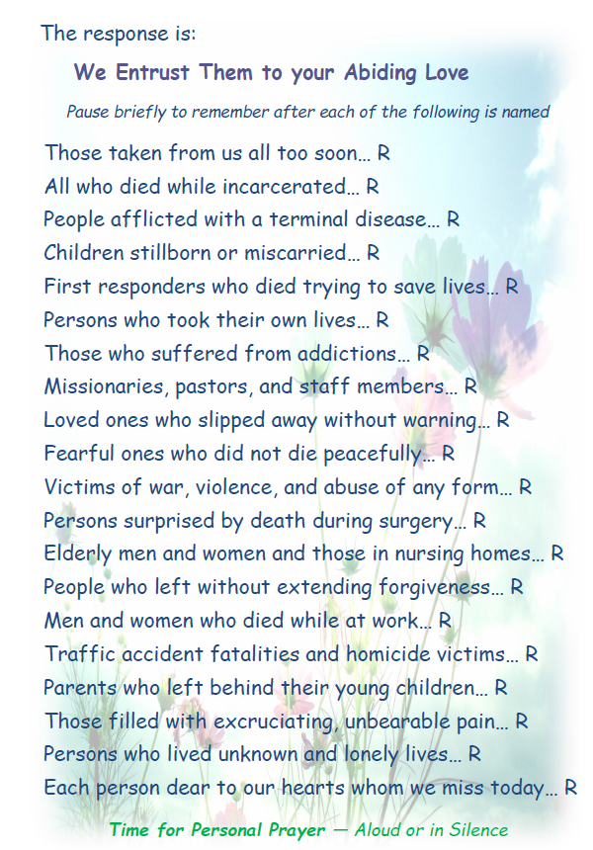

Slide 12
Hymn: Prayer for Protection
(Track 3, CD The Peace of God by Briege O’Hare, osc and sung by Marie Cox, rsm)
Or Let your Heart Take Comfort
(Track 15, CD Holy Ground by Monica Brown)
Or A Hymn of your choice.
Closing Prayer
Beloved Ancestors, Sisters, Family
Leader:
Members, Friends and Partners in ministry your presence stretches back through the ages.
It touches and influences the deep part of each of us today. Your strength sings in our spirits. Your courage abides in our hearts. Your resilience resonates in our bones. Your love abounds in our souls. May we remember how connected we are to
these enduring qualities. We offer gratitude for how the best of you continues to find life in us. Amen.

