Slide 1
November Prayer Service
Remembrance of our
Beloved Departed

Slide 2
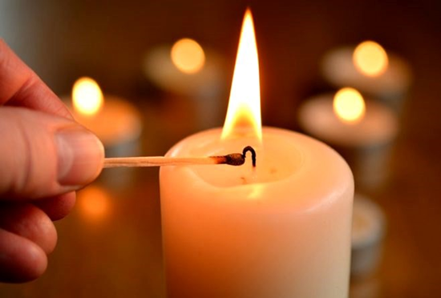
Opening Ritual
Introduction
Whether we come light with the joys of today or heavy with its burdens, we open ourselves to God’s presence as we light our candle, in the name of God who creates life, in the name of Jesus who loves life, in the name of the Spirit who is the fire of life.
(pause)

Slide 3
We give thanks for the gift of vulnerability by which we gain insight into the souls of others.
We give thanks for the privilege of knowing our loved ones who have died.
In the silence of our hearts we give thanks for the gift of this day
and pray for the life of the world. (Pause)

Slide 4
May the light of God illumine the hearts of our souls. May the flame of Christ kindle us to love.
May the fire of the Spirit free us to live, this day, tonight
and forever.

Slide 5
Choose One of The Following
Come Holy Spirit
(Track 2, CD-Time for Mercy, Catherine Teresa Martin RSM)
Consciousness Waking (Jan Novotka – Copy and paste this link into the Tool Bar on your computer to listen)
https://www.youtube.com/watch?v=UvC0BV7Z0CA
A hymn of your choice/time of silence.

Slide 6
Reading
Death is what alerts the rest of us to life. There is a period when the parts of us that died with the death of those we loved rises again in the recollection of past moments and the tears of past tenderness. This is when we know for certain that every deed we ever do lives on somewhere in someone who remembers it. This is when we are made to see death as a prod to life.
Death gives us all the gift of time, our own and the time of those around us. It calls us to stop and look at sunflowers next time, to care for the grasses always, to embrace the planet forever, to pay attention to our friends, to take comfort in the dark…… to remember that there is only one breath between life and death and that the important thing is to make every breath count, not only for ourselves but for others as well, to remember that there is the light that no darkness can take away.
The death of someone we know reminds us that we are still alive for a purpose. Our growing is not over yet; our giving is not finished.
Pause for reflection

Slide 7
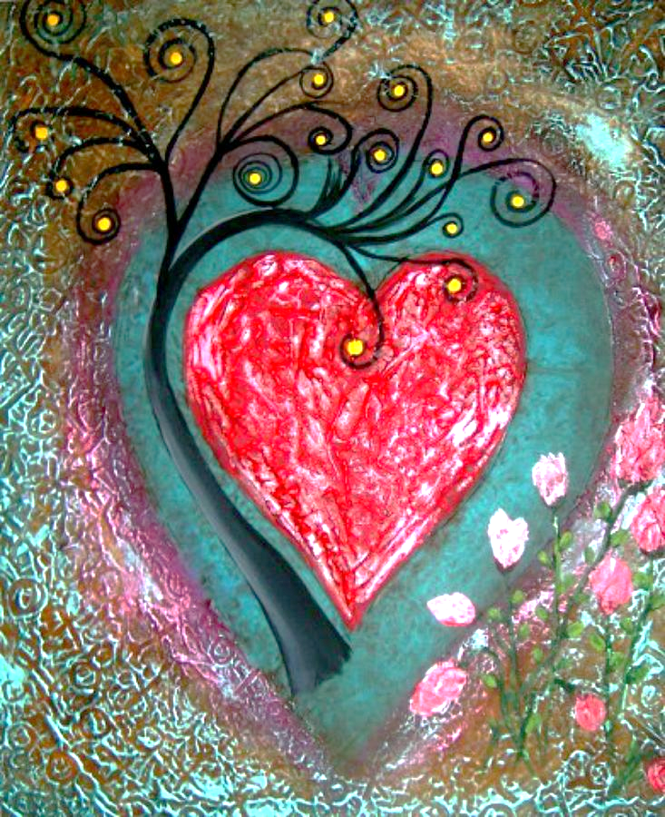
Psalm 34
Happy are all who dwell in the Beloved’s heart!
Abandon yourself into love’s hands O you holy ones, for
those who give themselves to the Beloved lack no good
thing. Everyone separated from Love is empty and hungry within;
But those who open their hearts to the Beloved are filled to overflowing!
Keep your heart open and free. Take time to dwell in the Silence.
Become a peaceful presence in the world.
For the Beloved sees the deeds of our hearts
and hears our innermost thoughts.
Though we are beset with many fears that cause illness and troubles, the Beloved is ever ready to comfort us in our sorrows, to strengthen us on our soul’s journey to wholeness. The Beloved renews the life of all who surrender to Love.
(Psalms for Praying. An invitation to wholeness. Nan C. Merrill)
As soft background music is played each person is invited to anoint the hand of a person beside them.
The person may choose whether to name silently
or openly a particular grieving at this time.

Slide 8
In the belief that we are partakers in the communion of saints we now take some time to recall those who have died and especially those who have died within this past year, for the inspi- ration these people have been to us and for the mystery of who we are and what we cannot see.
The Names of those who died are recalled

Slide 9
Reflection
Judy Cannato in her book “Radical Amazement” says that supernovas are the death eruptions of the stars. She says that the Hubble Space Telescope photographs of them are so stunningly beautiful that it is easy to forget that what we see are really images of passing away and coming to be, icons that lead us into the heart of Mystery itself. The giving over of life on behalf of ever-expanding creativity is integral to life itself. What is crucial is that we choose not to flee from death, but to meet it with grace. Like the supernova explosions that shatter every recognizable fragment of life, we are capable of transcendence, capable of never allowing death to have the final say. (Pages 118ff)
Pause for Reflection
We believe that God is present in the tomb of our waiting creating the miracles of goodness, of love, of grace, of the restoration of all things.
In the centre of our waiting seeds are announced in small signs.....
in small kindnesses.........
in humble courage.......................
in lives of fragile hope.................. in faithfulness.......
Life is stronger than death. This we believe.
From this we live.

Slide 10
Magnificat
(Track 6 CD-Time for Mercy, Catherine Teresa Martin RSM. Cover number 5) or a Magnificat of your choice.
Prayers of the faithful Our Father
Concluding Prayer
Glory be to you, O God for the gift of life unfolding through those who have gone before us.
Glory be to you, O God for your life planted within our souls and in every soul coming into the world.
Glory be to you, O God for the grace of new beginnings placed before us in every moment and encounter of life.
Glory, glory, glory for the grace of new beginnings in every moment of life. (Philip Newell)
Enveloped in God’s Light, may we be beacons to those in search of
Light.
Sheltered in God’s Peace, may we offer shelter to those in need of
peace.
Embraced by God’s Presence, may we be present to others that we
may be bearers of hope in our world.
May the blessings of heaven, the blessings of earth, and the bless- ings of sea and of sky be on those we love this day/evening/night and on every human family the gifts of heaven, the gifts of earth, the gifts of sea and of sky. Amen.

Slide 11
Suggested Final Hymns
Song of Blessings (Track no 12, CD-Time for Mercy, Catherine Teresa Martin RSM. Booklet number 11)
or
All is Light (Jan Novotka) Copy and paste this link into the Tool Bar on your computer to listen to and view beautiful images https://www.youtube.com/watch?v=sJ18COsS83E
or
A hymn of your choice/time of silence.

Slide 12
A Blessing for the Broken Hearted
Let us agree for now
that we will not say the breaking makes us stronger
or that it is better to have this pain than to have done without this love.
Let us promise we will not tell ourselves time will heal the wound
when every day our waking opens it anew.
Perhaps for now it can be enough to simply marvel at the mystery
of how a heart so broken can go on beating, as if it were made for precisely this—
as if it knows the only cure for love is more of it as if it sees the heart’s sole remedy
for breaking is to love still
as if it trusts that its own stubborn and persistent pulse
is the rhythm of a blessing we cannot begin to fathom but will save us nonetheless.
Jan Richardson

