Slide 1
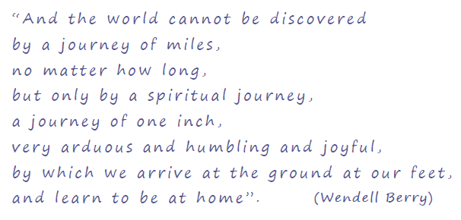
Remembrance of our beloved
Departed Sisters of Mercy

Slide 2
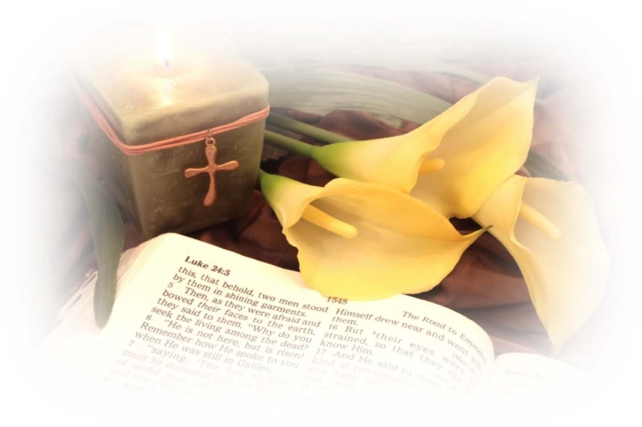
Soft music
lighting of the candle
Focus for a few moments on the candle and on the symbols in the centrepiece

Slide 3
Welcome: We come as a community, to our prayer time today to remember with love our mercy sisters, family members, friends and relatives who have died during this past year. Through our prayer and compassionate presence, may those who have lost loved ones find the strength and understanding they need to cope each day.
May we be patient with life and allow God’s mercy and love to be our constant strength. As we support one another in our grief, we pray that God will fill our hearts with deeper faith and stronger empathy.
Lighting of candle

Slide 4
Hymn: Retu r n Home
Return home Return home
Return to the essence of your being
Return to your truth, Return to your heart
Return and rest.
Return home Return home
Return to the peace that is your soul
Return to your truth, Return to your heart
Return and rest.
(CD Return Home by Jan Novotka)
( T o l i s t e n t o t h i s h y m n :
G o t o g o o g l e ,
T y p e I T u n e s R e t u r n H o m e b y J a n N o v o t k a
F i n d t h e C D c o v e r e n t i t l e d R e t u r n H o m e
C l i c k V i e w i n i T u n e s u n d e r n e a t h t h e C D c o v e r
C l i c k L a u n c h a p p l i c a t i o n
C l i c k N o t o t h e n e x t q u e s t i o n
C l i c k R e t u r n H o m e
O the rw i se p ra y s i l e n t l y th e abo v e wo r ds e n te r i n g i n t o the e s se nce a n d pe ace o f yo u r so u l o r s e l e c t a h ym n o f yo u r c ho i ce )
Pause
(Recall in silence the names of those you wish to remember this day.)
Pause

Slide 5
In the presence of God we remember and give thanks for their lives and the richness of hope that we have received from them.
(Chapter 3:21 -26)
I will call this to mind, as my reason for hope:
The favours of God are not exhausted.
God’s mercies are not spent;
They are renewed each morning, so great is God’s faithfulness. My portion is my God, says my soul;
Therefore I will hope in God.
Good is God to the one who waits and to the soul who seeks. It is good to hope in silence for the saving help of God.
This is the Word of God.
Pause
Choose Reflection 1 or 2

Slide 8
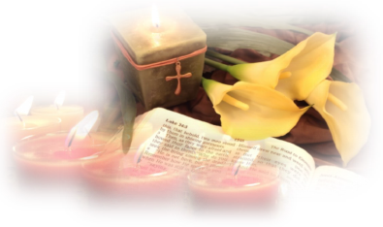
Prayerfully read the names of the sisters who died since last November.
If the name of a Sister from your community/cluster is read, a member of the group comes forward to light a candle/night light in remembrance of her and places it on the centrepiece.
On the centrepiece, Sisters may have placed their own memorial cards, photographs or symbols of remembrance of a community member, a family member, a friend or a relative.
Invite Sisters to take some time to name and pray for their loved ones who have died.
They also may wish to come forward and light a candle/night light in honour of their loved one who has died.

Slide 9
Death alerts us to life In the recollection of past moments and the tears of past tenderness In the knowledge that every deed we ever do lives on somewhere In our awareness of the gift of time In stopping to look at flowers, In caring for nature In embracing the planet, In paying attention In taking comfort in the darkness and the light. In remembering ‘The Light’ that no darkness can take away.
Pause

Slide 11
We pray for the people of the world and for our leaders that the Christian vision of peace, hope and justice for all may everywhere be respected. Lord, hear us.
We pray for the needy of all continents and countries, particularly those who have experienced great hardship and trauma in recent times. Lord, hear us.
We remember the members of our Congregation, our families, relations and friends as we recall their lives of love and hope. We remember them with affection and gratitude,
and commend them to the care of our loving God.
Lord, hear us.
We pray for all who care for the sick and the dying especially those who care for our sick sisters. Lord, hear us.
We pray that we will continue to be a compassionate presence of God to those who grieve the death of loved ones.
Lord, hear us.
We pray for a deeper awareness of our interdependence and interconnectedness with all of life. Lord, hear us.

Slide 12
Pray together The Lord’s Prayer
Let us pray:
Spirit of God, allow us to release our loves ones to You,
still feeling their abiding love and knowing their guidance.
Let us stand in solidarity, as they would wish with the courage of a community of Hope- Being Hope to each other and to all of creation. May we return to your truth and to the essence of our being. Through Christ our Lord. Amen

Slide 13
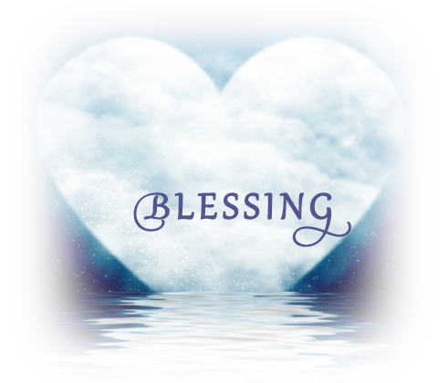
May we go forth with joy and hope.
May we go forth with remembering hearts, grateful for all that we have shared.
May we go forth with arms held wide,
open to what God sends to us for merciful embrace.
May we go forth as we take our journey inch by inch to walk the ways of mercy.
May we go forth with enthusiastic faith in God, in one another and in all of life.
May God the Trinity of love - Creator, Word and Wisdom- Bless each one of all and all whom we love. (Adapted from Mary Wickham rsm)

Slide 14
When Death Comes
When death comes…
I want to step through the door full of curiosity…
Therefore I look upon everything
as a brotherhood and a sisterhood…
and I think of each life as a flower…
and each name a comfortable music in the mouth tending as all music does, toward silence,
and each body a lion of courage, and something
precious to the earth.
When it's over, I want to say: all my life I was a bride married to amazement…
When it's over, I don't want to wonder
if I have made of my life something particular, and real.
I don't want to find myself sighing and frightened or full of argument.
I don't want to end up simply having visited this world.
Mary Oliver (House of Light)

Slide 15
Mercy Congregational Leadership Team
Rachamim, 13/14 Moyle Park, Convent Road, Clondalkin, Dublin 22, Ireland.

