Slide 3
“…and the skies show the work of God’s hands” (PS 19)

Slide 7
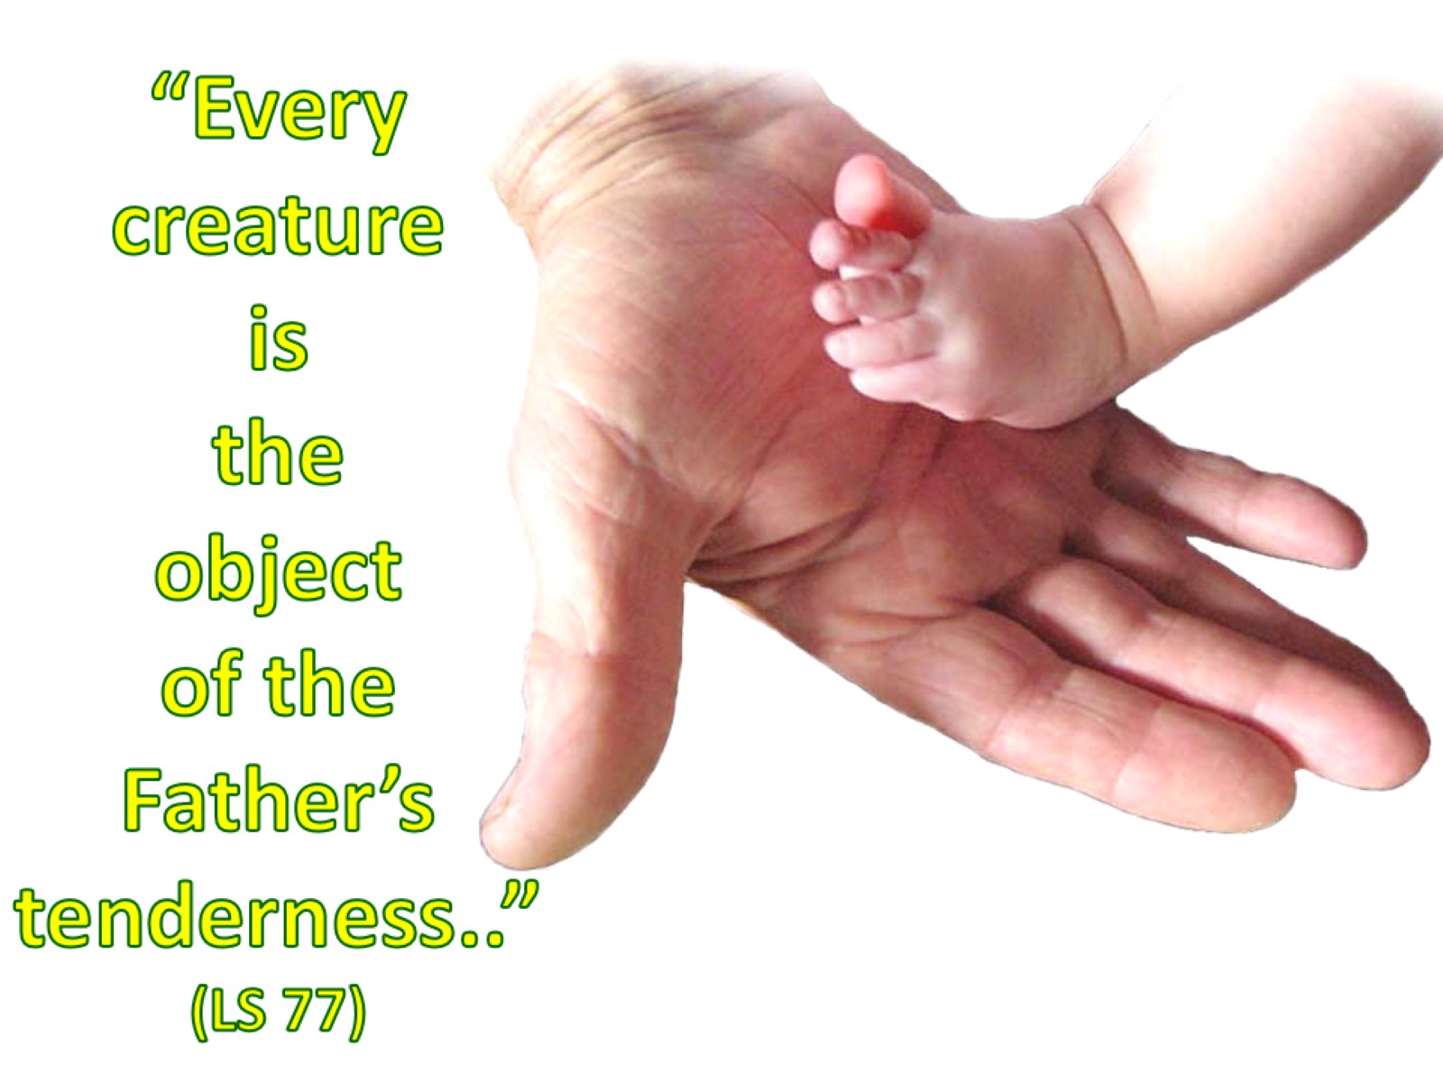

Slide 12
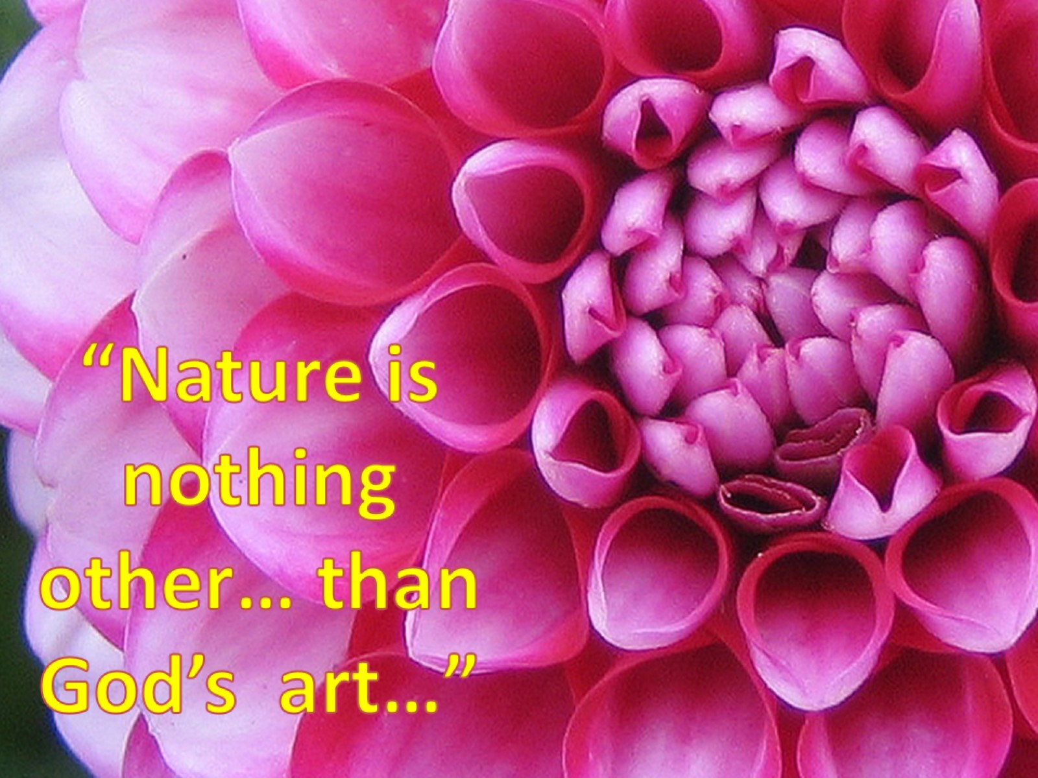

Slide 14
